Slide 1


📻 92.7 Big FM's history
Presented by Nivin K P

Slide 2


Challenge
In this challenge I have used Mysql to solve the question. we have Shows, Partnerships, ShowPartnerships, Awards and OnlinePresence tables present in this challenge
Challenge is to craft SQL queries to extract insights from the 92.7 BIG FM radio network database. We have multiple table in the dataset from this we have to find the solution for our quries.

Slide 3

Questions Used
1)Retrieve all stations in the "East" region? 2)List all shows hosted by "Vrajesh Hirjee"? 3)Count the number of awards each show has won? 4)Find shows that have partnerships with "Spotify"? 5)Retrieve hosts who joined before 2010? 6)List the shows and their launch dates in descending order of launch date? 7)Find the total count of shows for each host? 8)Show the online presence platforms with their links? 9)Retrieve the stations in the "South" region launched before 2010?

Slide 4
Tables used
Onlinepresence
Shows
Hosts
Awards
Partnerships
Showpartnership

Slide 5

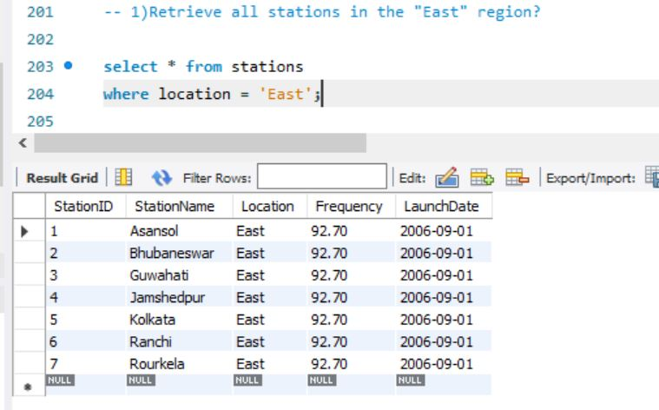
Q1.Retrieve all stations in the "East" region?

Slide 6
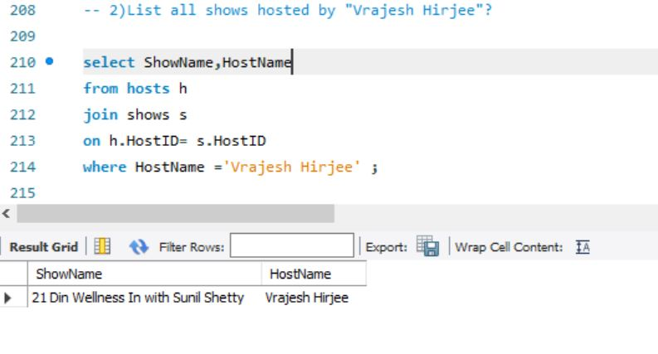
Q2.List all shows hosted by "Vrajesh Hirjee"?

Slide 7
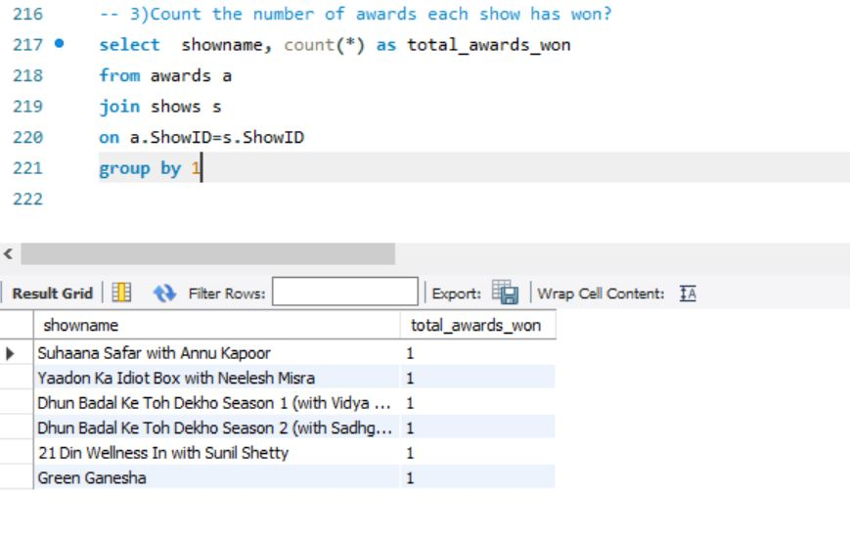
Q3.Count the number of awards each show has won?

Slide 8
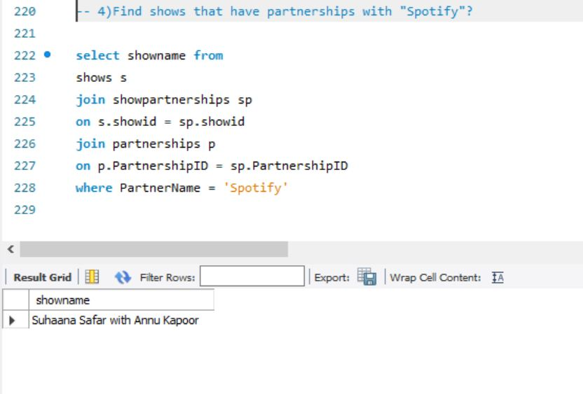
Q4.Find shows that have partnerships with "Spotify"?

Slide 9
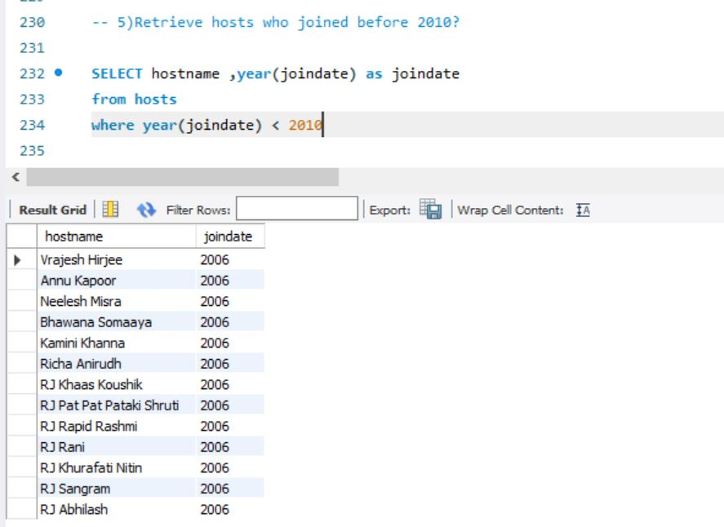
Q5.Retrieve hosts who joined before 2010?

Slide 10
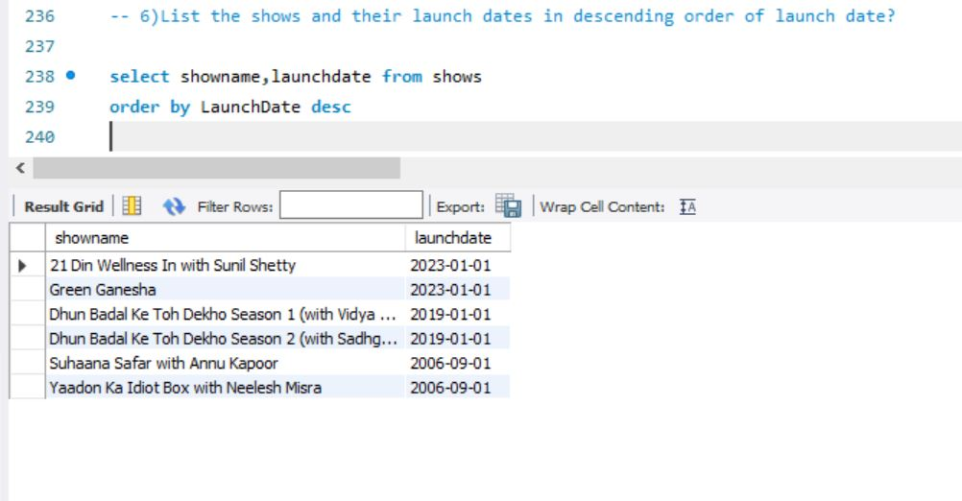
Q6.List the shows and their launch dates in descending order of launch date?

Slide 11
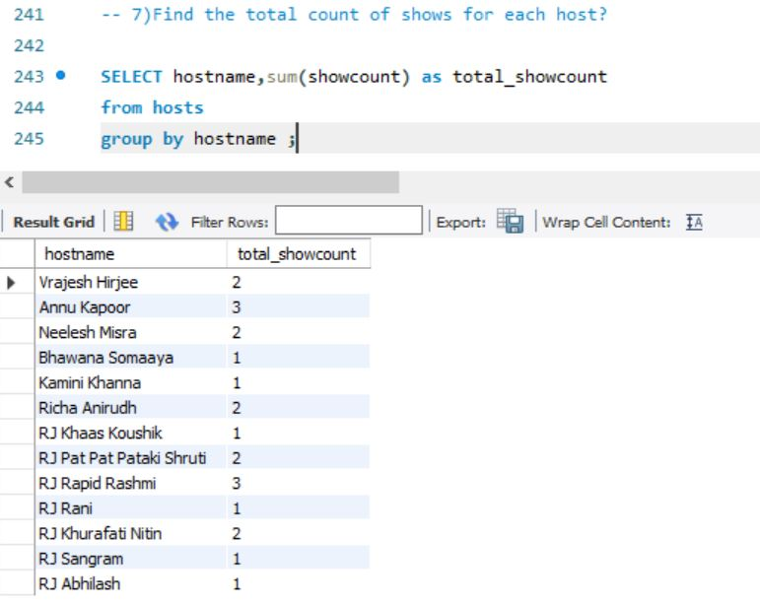
Q7.Find the total count of shows for each host?

Slide 12
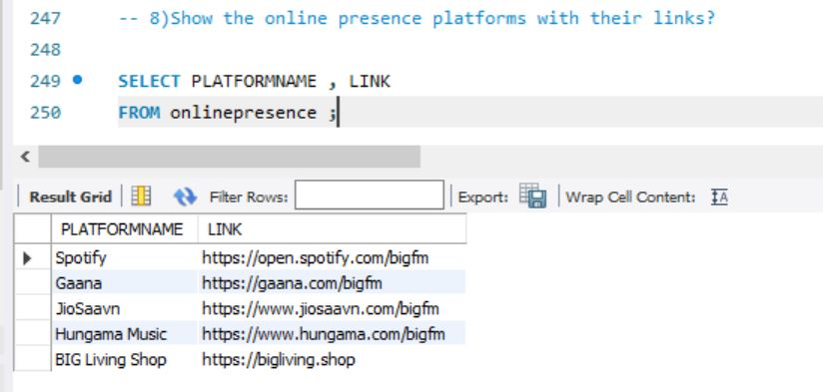
Q8.Show the online presence platforms with their links?

Slide 13
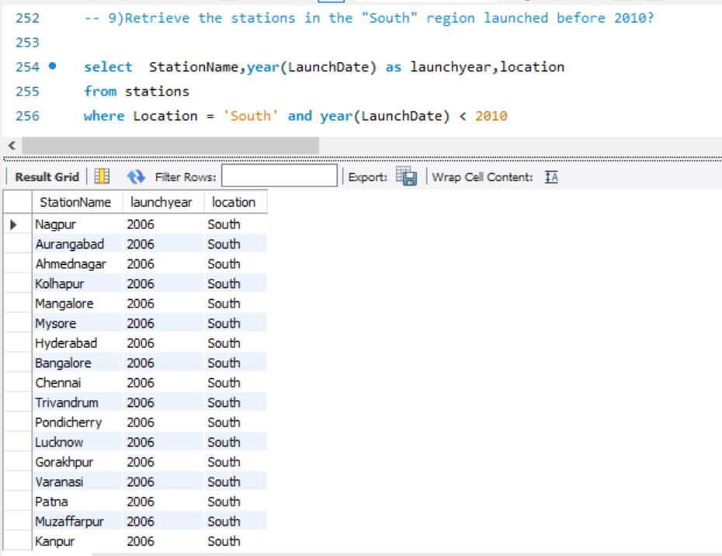
Q9.Retrieve the stations in the "South" region launched before 2010?

Slide 14

Thank you

